Slide 1

Principal Component Analysis
Berivan Melissa Gürpınar

Slide 2
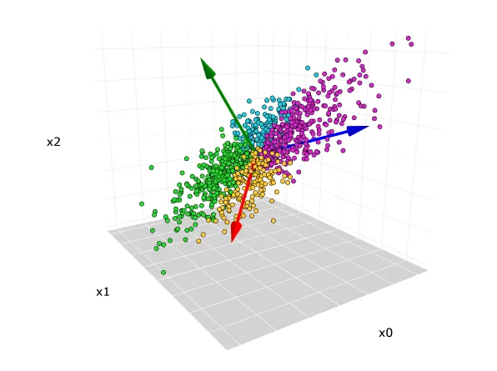

What is PCA?
Principal component analysis (PCA) is a technique that transforms high-dimensions data into lower-dimensions while retaining as much information as possible.
The original 3-dimensional data set
Notes:
Principal components analysis (PCA) is one of a family of techniques for taking high-dimensional data and using the dependencies between the variables to represent it in a more tractable, lower-dimensional form, without losing too much information.

Slide 3
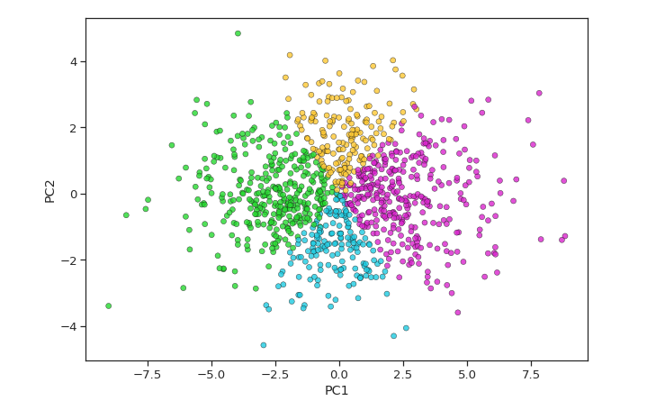
Scatterplot after PCA reduced from 3-dimensions to 2-dimensions
Notes:
One important thing to note about PCA is that it is an Unsupervised dimensionality reduction technique, you can cluster the similar data points based on the feature correlation between them without any supervision (or labels)

Slide 4
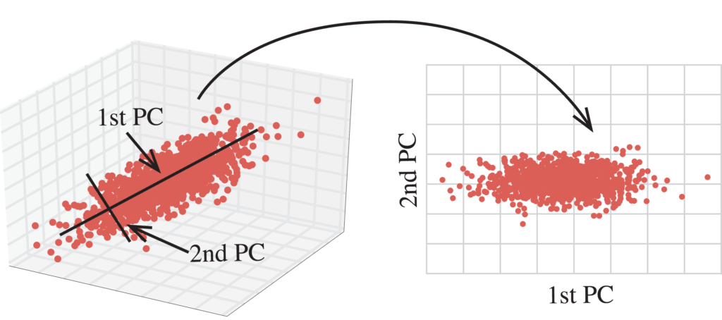
Dimensionality Reduction And Visualization
Here you can see, in the first image, it is three-dimensional data with X,Y, Z axes. The second image is a two-dimensional space with PC1, PC2 as axes.
In statistics, dimension reduction techniques are a set of processes for reducing the number of random variables by obtaining a set of principal variables. For example, in the context of a gene expression matrix across different patient samples, this might mean getting a set of new variables that cover the variation in sets of genes. This way samples can be represented by a couple of principal variables instead of thousands of genes. This is useful for visualization, clustering and predictive modelling.

Slide 5
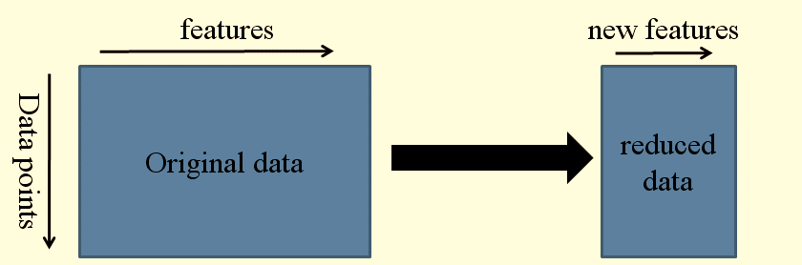

Slide 6
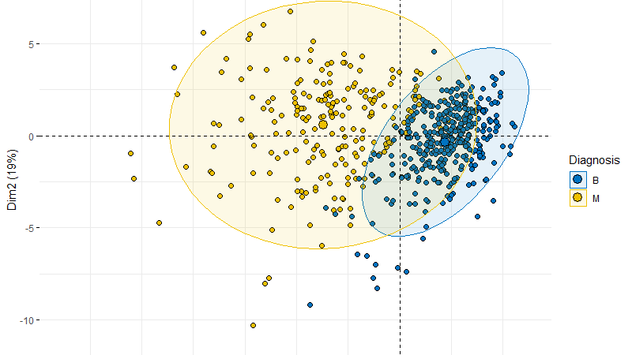
Advantages of PCA Principal Component Analysis (PCA) is a commonly used technique in academic research, particularly in fields such as statistics, machine learning, and data analysis. Some of the advantages of using PCA.

Slide 7
Dimensionality reduction: One of the main advantages of PCA is its ability to reduce the dimensionality of the data while preserving most of the important information. This can be particularly useful in academic research, where datasets can be large and complex.
Feature extraction: PCA can also be used for feature extraction, where the most important features of a dataset can be identified and extracted for further analysis. This can be helpful in identifying important variables in a dataset and can also reduce the computational complexity of subsequent analyses.
Visualization: PCA can also be used for data visualization, where data can be projected onto a lower-dimensional space for easier visualization and interpretation. This can be helpful in identifying patterns and relationships in data and can also aid in data exploration.
Data preprocessing: PCA can also be used for data preprocessing, where data can be standardized and normalized before analysis. This can help to reduce noise and improve the accuracy of subsequent analyses.

Slide 8
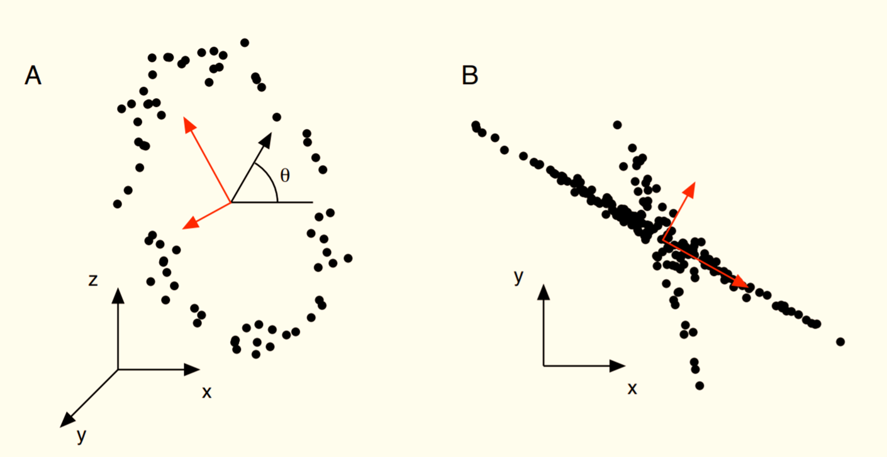
Disadvantages of PCA

Slide 9
Interpretability: The resulting principal components are often difficult to interpret in a meaningful way. While they may capture a large amount of variance in the data, it may not be clear what specific features or variables are being represented by each component.
Data scaling: When the data is not scaled properly, PCA may not perform optimally, and the resulting principal components may not accurately represent the variance in the original data.
Outliers: Outliers can influence the calculation of principal components and result in components that do not accurately capture the variance in the data.
Correlation: PCA assumes that the variables in the data set are uncorrelated. When there is high correlation between variables, PCA may not work well, as the resulting principal components may not accurately capture the underlying structure of the data.
Data distribution: When the data is normally distributed, PCA works best. If the data is heavily skewed or contains extreme values, PCA may not perform optimally.
Sample size: PCA may not be appropriate for small sample sizes. When the sample size is small, the resulting principal components may not accurately represent the underlying variance in the data.

Slide 10

Linearity Assumption
Sensitivity to Outliers
Dependence on Data Scaling
Information Loss
Interpretability
Correlation Structure
Sample Size

Slide 11


Slide 12
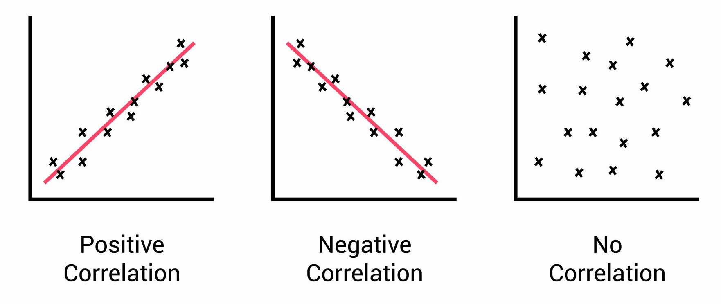
Correlation
A statistical measure known as correlation expresses the direction and strength of the linear connection between two variables. The covariance matrix, a square matrix that displays the pairwise correlations between all pairs of variables in the dataset, is calculated in the setting of PCA using correlation. The covariance matrix's diagonal elements stand for each variable's variance, while the off-diagonal elements indicate the covariances between different pairs of variables.

Slide 13
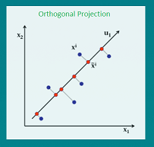
Orthogonal
The term "orthogonality" alludes to the principal components' construction as being orthogonal to one another in the context of the PCA algorithm. This indicates that there is no redundant information among the main components and that they are not correlated with one another.
Orthogonality in PCA is mathematically expressed as follows: each principal component is built to maximize the variance explained by it while adhering to the requirement that it be orthogonal to all other principal components. The principal components are computed as linear combinations of the original variables. Thus, each principal component is guaranteed to capture a unique and non-redundant part of the variation in the data.

Slide 14
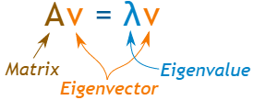
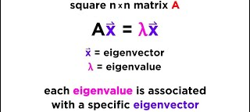
Eigen Vectors
Eigenvector is a non-zero vector that only changes the magnitude not direction when subjected to a linear transformation.
It means that if we multiply a non-zero vector with the above covariance matrix then the result would be a scaled version of the initial vector and that scaled value is the eigenvalue.
Mathematically, when an eigenvector is multiplied with a vector will give the product of the eigenvector and a scalar value.

Slide 15
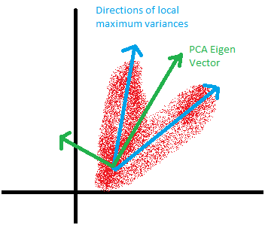
Notes:
The main components of the data are calculated using the eigenvectors. The ways in which the data vary most are represented by the eigenvectors of the data's covariance matrix. The new coordinate system in which the data is represented is then defined using these coordinates.

Slide 16

Covariance Matrix
The covariance matrix is a p × p symmetric matrix (where p is the number of dimensions) that has as entries the covariances associated with all possible pairs of the initial variables. For example, for a 3-dimensional data set with 3 variables x, y, and z, the covariance matrix is a 3×3 data matrix of this from:
Since the covariance of a variable with itself is its variance (Cov(a,a)=Var(a)), in the main diagonal (Top left to bottom right) we have the variances of each initial variable. And since the covariance is commutative (Cov(a,b)=Cov(b,a)), the entries of the covariance matrix are symmetric with respect to the main diagonal, which means that the upper and the lower triangular portions are equal.

Slide 17
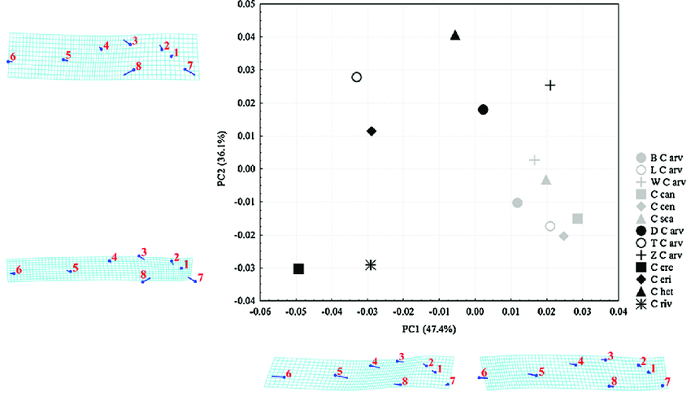
Principal component analysis (PCA), the covariance matrix of Procrustes coordinates averaged by population for the ventral region of Aceria spp. Abbreviations for populations (European black symbols; North American grey symbols) are given in the legend of changes, magnified three times, are presented in the form of TPS transformation grids along the first (PC1) and second (PC2) axis

Slide 18
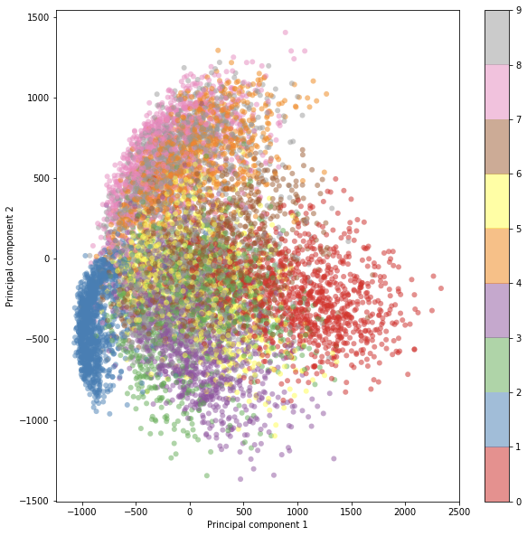
Step-by-Step Explanation of PCA
Notes:
Column standardize your data.
Find the covariance matrix.
Find all eigenvalues and eigenvectors of the covariance matrix.
Then v1 corresponding to largest eigenvalue lambda1 is the direction with maximum variance, v2 corresponding to lambda 2 is the direction with second maximum variance and so on.
To get k features, multiply the original data matrix with the matrix of eigenvectors corresponding to top k largest eigenvalues.

Slide 19
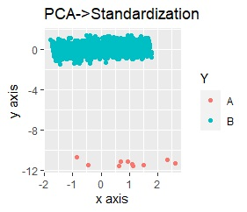
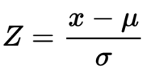
STEP 1: STANDARDIZATION
The aim of this step is to standardize the range of the continuous initial variables so that each one of them contributes equally to the analysis.
Mathematically, this can be done by subtracting the mean and dividing by the standard deviation for each value of each variable.
Once the standardization is done, all the variables will be transformed to the same scale.
Standardize the data before performing PCA.
This will ensure that each feature has a mean = 0
and variance = 1.
Notes:
The reason why it is critical to perform standardization prior to PCA, is that the latter is quite sensitive regarding the variances of the initial variables. That is, if there are large differences between the ranges of initial variables, those variables with larger ranges will dominate over those with small ranges (for example, a variable that ranges between 0 and 100 will dominate over a variable that ranges between 0 and 1), which will lead to biased results. So, transforming the data to comparable scales can prevent this problem.

Slide 20
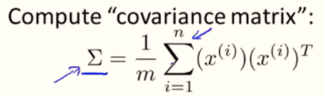
STEP 2: COVARIANCE MATRIX COMPUTATION
The aim of this step is to understand how the variables of the input data set are varying from the mean with respect to each other, or in other words, to see if there is any relationship between them. Because sometimes, variables are highly correlated in such a way that they contain redundant information. So, in order to identify these correlations, we compute the covariance matrix.

Slide 21
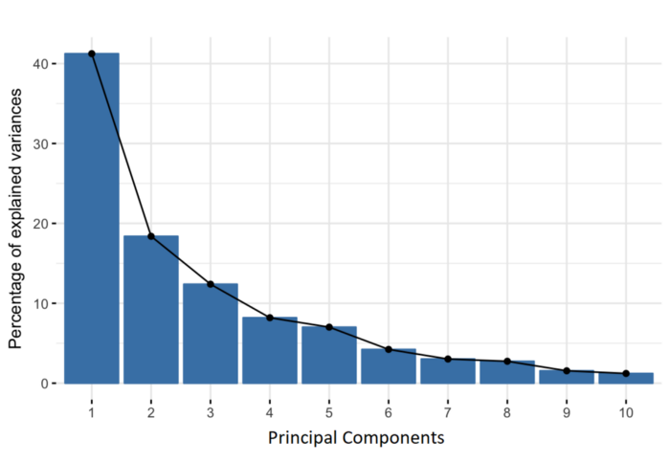
STEP 3: COMPUTE THE EIGENVECTORS AND EIGENVALUES OF THE COVARIANCE MATRIX TO IDENTIFY THE PRINCIPAL COMPONENTS
Eigenvectors and eigenvalues are the linear algebra concepts that we need to compute from the covariance matrix in order to determine the principal components of the data.
Principal components are new variables that are constructed as linear combinations or mixtures of the initial variables. These combinations are done in such a way that the new variables (i.e., principal components) are uncorrelated and most of the information within the initial variables is squeezed or compressed into the first components.
Percentage of Variance (Information) for each by PC.
Notes:
Organizing information in principal components this way, will allow you to reduce dimensionality without losing much information, and this by discarding the components with low information and considering the remaining components as your new variables.
An important thing to realize here is that the principal components are less interpretable and don’t have any real meaning since they are constructed as linear combinations of the initial variables.
Geometrically speaking, principal components represent the directions of the data that explain a maximal amount of variance the lines that capture most information of the data. The relationship between variance and information here, is that the larger the variance carried by a line, the larger the dispersion of the data points along it, and the larger the dispersion along a line, the more information it has.
To put all this simply, just think of principal components as new axes that provide the best angle to see and evaluate the data, so that the differences between the observations are better visible.

Slide 22
STEP 4: FEATURE VECTOR
In this step, what we do is, to choose whether to keep all these components or discard those of lesser significance (of low eigenvalues), and form with the remaining ones a matrix of vectors that we call Feature vector.
So, the feature vector is simply a matrix that has as columns the eigenvectors of the components that we decide to keep. This makes it the first step towards dimensionality reduction, because if we choose to keep only p eigenvectors (components) out of n, the final data set will have only p dimensions.
STEP 5: RECAST THE DATA ALONG THE PRINCIPAL COMPONENTS AXES
In this step, which is the last one, the aim is to use the feature vector formed using the eigenvectors of the covariance matrix, to reorient the data from the original axes to the ones represented by the principal components (hence the name Principal Components Analysis). This can be done by multiplying the transpose of the original data set by the transpose of the feature vector.

Slide 23
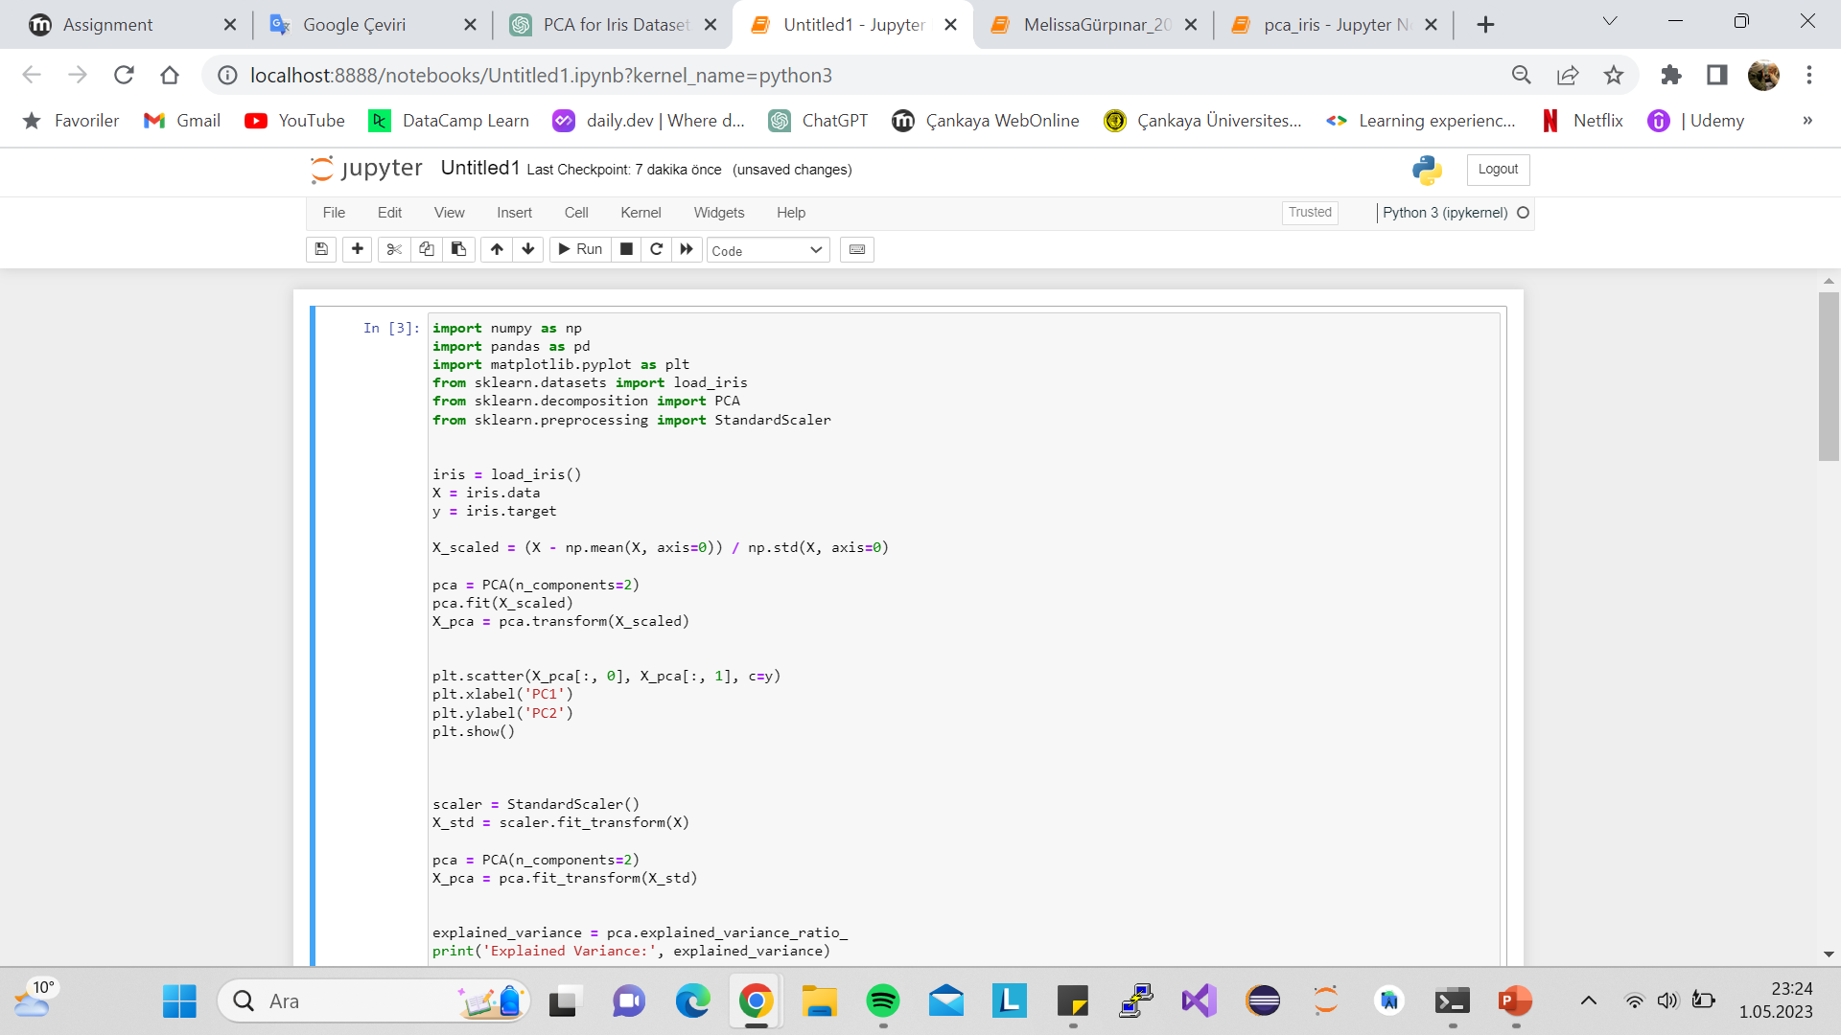
Step 1: Import necessary libraries: numpy, pandas, matplotlib, scikit-learn's load_iris, PCA and StandardScaler classes.
Step 2: Load the Iris dataset using load_iris() function from scikit-learn. The data is stored in the variable 'iris' as a dictionary. Extract the features and target variables from the 'iris' dictionary and store them in the variable's 'X' and 'y' respectively.
Step 3: Standardize the feature data using the StandardScaler() function from scikit-learn, which scales the data to have a mean of zero and a standard deviation of one.
Step 4: Perform PCA on the standardized feature data using the PCA() function from scikit-learn. Here, we specify the number of principal components to keep as 2.
Step 5: Transform the standardized feature data into 2 principal components using the transform() method of the PCA object created in the previous step.

Slide 24
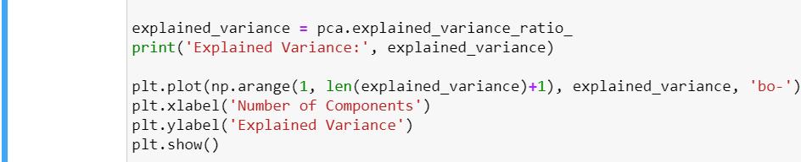
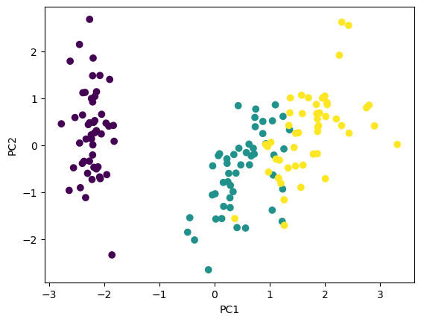
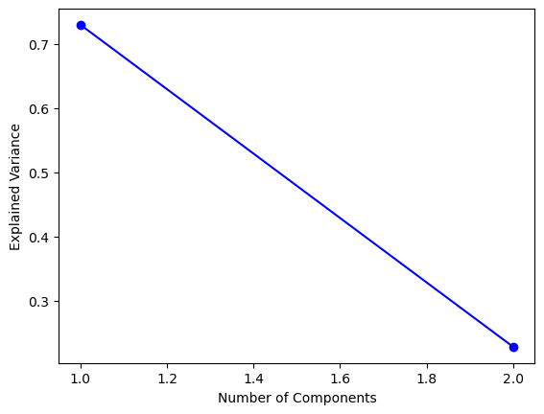
Step 6: Visualize the results by plotting a scatter plot with the first principal component on the x-axis and the second principal component on the y-axis. The color of the dots represents the different classes of the target variable.
Step 7: Compute and plot the explained variance of each principal component using the explained_variance_ratio_ attribute of the PCA object.

Slide 25
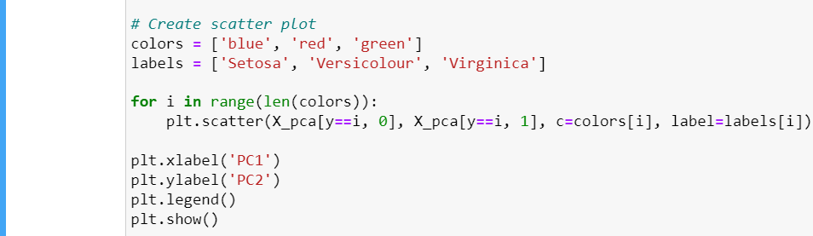
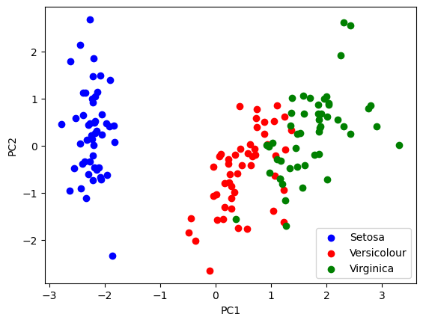
Step 9: Create a scatter plot of the first two principal components colored by the different classes of the target variable.

Slide 26
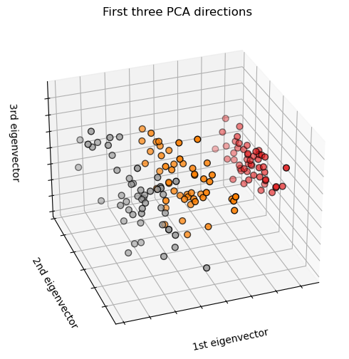
This code uses the Pandas and Matplotlib libraries in Python to visualize a portion of a dataset called the "iris" dataset.
Notes:
Specifically, the code creates a scatter plot of the sepal length and width and petal length and width of the flowers in the iris dataset using the first 100 examples.
Here's how the code works:
First, the iris dataset is loaded using the "pandas" library.
Then, the first 100 examples are selected and stored in a new DataFrame.
The "matplotlib.pyplot" library is used to create a new figure and set its size.
A scatter plot is created using the sepal length and width and petal length and width as the x and y axes, respectively, and the flower species as the color of each point.
Labels are added to the x and y axes and a title is added to the plot.
The plot is displayed using the "show" function from the "matplotlib.pyplot" library.

Slide 27
REFERENCES
https://www.kaggle.com/code/shrutimechlearn/step-by-step-pca-with-iris-dataset
https://www.analyticsvidhya.com/blog/2021/09/pca-and-its-underlying-mathematical-principles/
https://medium.com/analytics-vidhya/mathematics-behind-principal-component-analysis-pca-1cdff0a808a9
https://www.researchgate.net/figure/Principal-component-analysis-PCA-the-covariance-matrix-of-procrustes-coordinates_fig2_263295966
https://www.simplilearn.com/tutorials/machine-learning-tutorial/principal-component-analysis
https://builtin.com/data-science/step-step-explanation-principal-component-analysis
https://medium.com/analytics-vidhya/understanding-principle-component-analysis-pca-step-by-step-e7a4bb4031d9
https://www.geeksforgeeks.org/mathematical-approach-to-pca/
https://www.turing.com/kb/guide-to-principal-component-analysis
https://dataaspirant.com/principal-component-analysis-pca/#t-1609906201495
https://sebastianraschka.com/Articles/2015_pca_in_3_steps.html
https://sebastianraschka.com/Articles/2015_pca_in_3_steps.html
https://blog.devgenius.io/the-role-of-eigenvalues-in-pca-c177718c2cc
https://www.quora.com/What-are-the-disadvantages-of-a-PCA
https://stats.stackexchange.com/questions/2691/making-sense-of-principal-component-analysis-eigenvectors-eigenvalues
https://ieeexplore.ieee.org/document/5522134
https://pubs.acs.org/doi/full/10.1021/ac800110w
https://statisticsglobe.com/advantages-disadvantages-pca

